Slide 1
Progressive damage analysis of Composite laminates with big cutouts
Chu PengCheng
2018.01.10

Slide 2
Numerical Model
Hashin Criteria & Continumm Damage Model(CDM)
Ply-discount Method VS CDM
Degeneration Model(linear vs exponential)
Shear Nonlinearity
in-situ strength effect
Abaqus Simulation
Modeling Technique
UMAT subroutine
characteristic length
coefficient of viscosity
implicit dynamic
Results & Conclusions

Slide 3
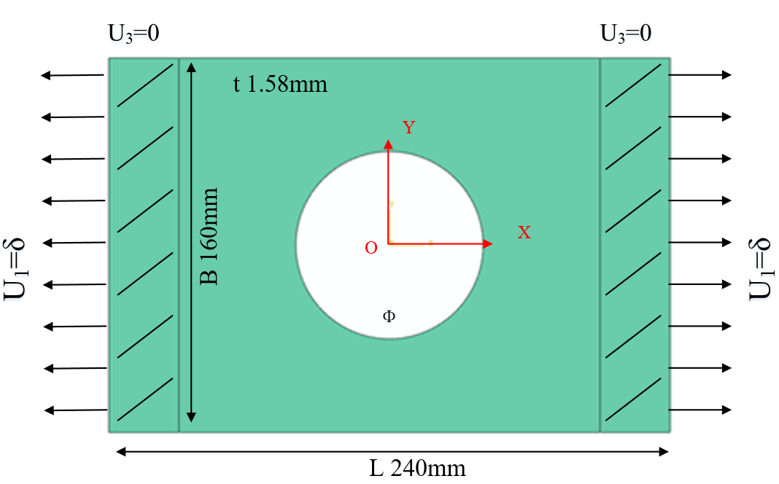
Problem：
FEM：Abaqus
Model: 3D Shell(SC8R)
Strength criterion：Hashin
Ф: 60mm, 80mm, 100mm
Layups: [0˚]₁₀, [0˚/90˚]₅, [±45˚]₅
Table 1 Material properties of a single lamina
ρ（kg/m³） | E₁(GPa) | E₂(GPa) | G₁₂(GPa) | υ₁₂
1520.7 | 127.70 | 9.67 | 6.50 | 0.30
Table 2 Strength parameters of a single lamina
Strength | X_{t} | X_{c} | Y_{t} | Y_{c} | S₁₂
(MPa) | 1518 | 764.3 | 36.0 | 160.3 | 60

Slide 4
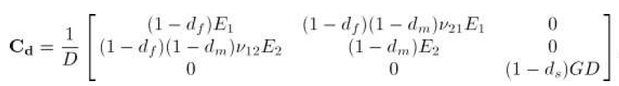
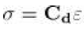
Numerical Model
Hashin criteria & Continuum Damage Model
Constitutive damage model:
To establish a constitutive law, it is possible to define a scalar function corresponding to the complementary free energy density in the material.The proposed definition for the ply complementary free energy density is:
The damage variables as a measure of the effective surface density of the microdefects.
The strain tensor is equal to the derivative of the complementary free energy density with respect to the stress tensor:
The lamina compliance tensor:
Inverse matrix is the stiffness tensor:
P. Maimí, P.P. Camanho, J.A. Mayugo, et al. A continuum damage model for composite laminates: Part I – Constitutive model[J]. Mechanics of Materials, 2007, 39:897–908.

Slide 5
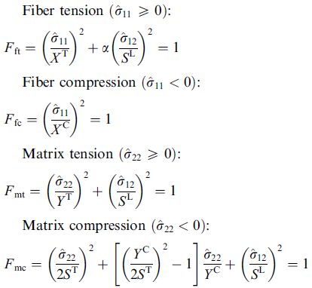
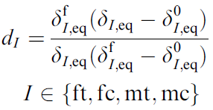
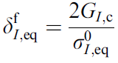
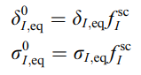
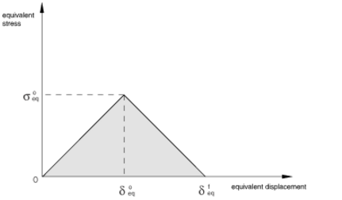
Numerical Model
Hashin criteria & Continuum Damage Model
Hashin criterion
The Continuum Damage Model:
Damage constitutive matrix:
Damage variable:
Lapczyk I, Hurtado J A. Progressive damage modeling in fiber-reinforced materials[J]. Composites Part A Applied Science & Manufacturing, 2007, 38(11):2333-2341.

Slide 6
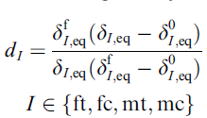
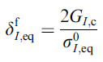
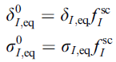
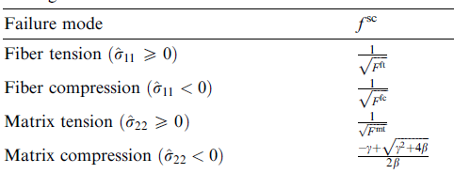
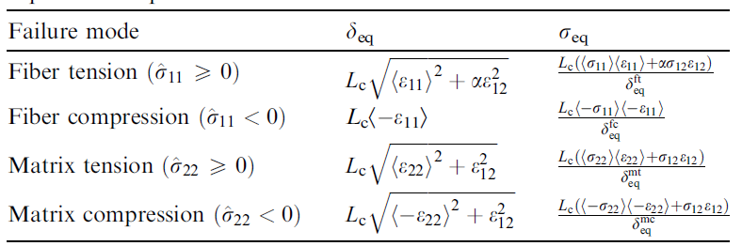
Numerical Model
Hashin criteria & Continuum Damage Model
Damage variables calculation：
damage variables:
Jaccobian matirx:

Slide 7
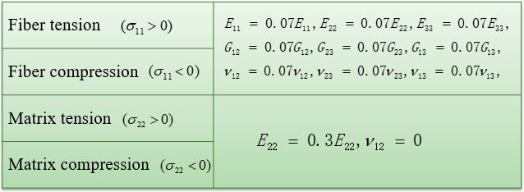
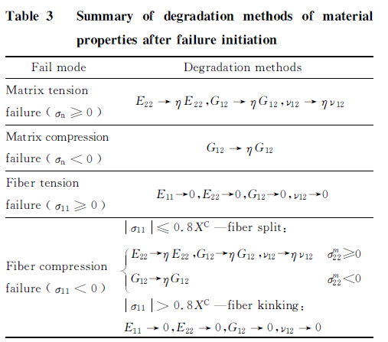
Numerical Model
Ply-discount Method VS CDM
Stiffness reduction model:
Ply-discount VS CDM ：
折减法 | CDM法
通过乘以折减系数使刚度矩阵退化，是一种半经验法(semiempirical )的探索模型 | 基于不可逆过程的热力学，将势能定义为损伤变量的函数，损伤变量定义了应力应变的关系，同时取决于能量耗散值
折减系数的不确定 | 所有使用参数均可测量得到
不能模拟层合板的准脆性失效 | 可以模拟材料的弹脆性行为
不能计算层合板的损伤演化过程 | 可以计算层合板的损伤演化过程
在abaqus中使用USDFLD子程序实现 | 在abaqus中使用UMAT子程序实现
Wang Danyong, Wen Weidong, Cui Haitao. Three-Dimensional progressive damage analysis of composite laminates containing a hole subjected to tensile loading. Chinese Journal of Theoretical and Applied Mechanics, 2005, 37(6):788-795.
Li B,Li Y Z,Yang F.Theoretical methodology for laminated composite strength including in-situ effect[J]. Acta Aeronautica et Astronautica Sinica, 2014, 35(11): 3025-3036

Slide 8
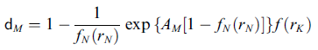
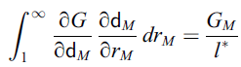
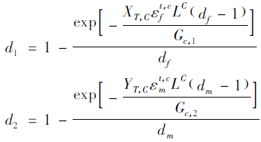
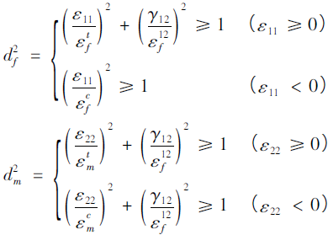
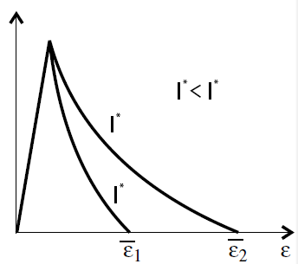
Numerical Model
Degeneration Model(linear vs exponential)
Linear degenaration:
Exponential degenaration:
Damage variable:
Damage variable:
Maimí P, Camanho P P, Mayugo J A, et al. A continuum damage model for composite laminates: Part II – Computational implementation and validation[J]. Mechanics of Materials, 2007, 39(10):909–919.
Lapczyk I, Hurtado J A. Progressive damage modeling in fiber-reinforced materials[J]. Composites Part A Applied Science & Manufacturing, 2007, 38(11):2333-2341.
Damage and Failure Study of Composite Laminates with
Reinforced Cutout Based on CDM
Wang Wenzhi，Wan Xiaopeng，Yao Liaojun

Slide 9
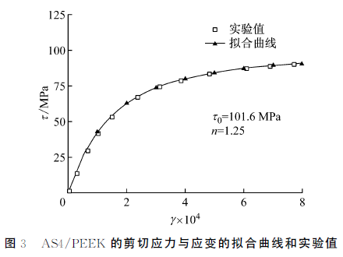
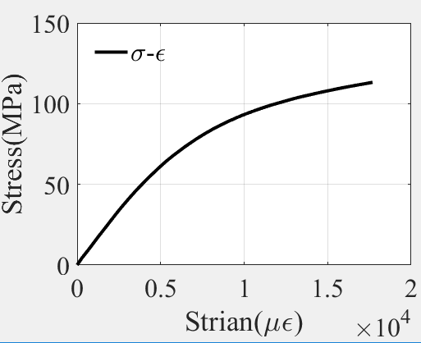
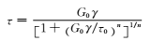
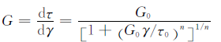
Numerical Model
——Shear Nonlinearity
shear nonlinearity constitutive relations for the laminates were defined with the Ramberg-Osgood equation:
刘魏光, 余音, 汪海. 考虑剪切非线性的复合材料渐进损伤模型[J]. 上海交通大学学报, 2016, 50(2):194-199.

Slide 10
Numerical Model
——in-situ effect
在传统强度理论研究中，通常将单向板试验获得的拉伸、压缩和剪切强度值作为材料的固有属性并用于建立强度准则，进而预测多向层合板的强度。然而通过一系列试验研究发现，对于铺层方向和厚度都相同的子层，它在多向层合板内和在单向板内时表现出的基体强度（包括横向拉伸和剪切强度）不同，在层合板内表现的强度明显高于在单向板内，许多文献将层合板的这种现象称为就地效应（in-situ effect）。
李彪，李亚智，杨帆．考虑复合材料层合板就地效应的强度理论[J]．航空学报，2014，35(11)：3025-3036
By examining the results presented previously,5±7 we take the in-situ tensile transverse and shear strengths to be 1.5 times those measured from unidirectional laminates for all the laminates discussed.
Sun C T, Tao J. Prediction of failure envelopes and stress/strain behaviour of composite laminates 1[J]. Composites Science & Technology, 1998, 58(7):1125-1136.
为单层板的固有横向拉伸强度与固有面内剪切强度， 为单层板在层合板中相应的就低强度，ABCD为材料相关的常数，N为层合板中同一方向并相邻的单层板的层数。 是本单层的纤维铺设角度与其相邻的两个单层板纤维铺设角度之差。
Wang J, Karihaloo B L. Optimum In Situ Strength Design of Composite Laminates. Part I: In Situ Strength Parameters[J]. Journal of Composite Materials, 1996, 30(12):1314-1337.

Slide 11
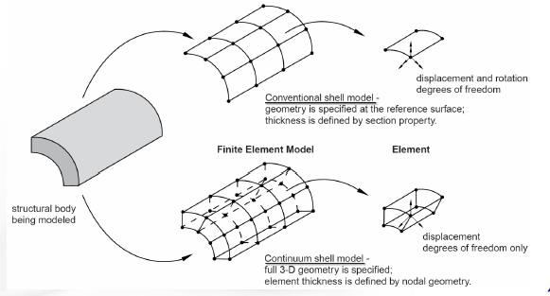
Abaqus Simulation
—Modeling Technique
Element choise:
conventional shell (where only the shell reference surface is discretized只有壳参考面被离散)
continuum shell (where a 3D volume is discretized but the kinematic behavior of the element is based on shell theory网格离散的是三维图形，但单元的动力学行为是基于壳理论计算的)(SC6R and SC8R)
solid element(C3D8R)
Continuum shell elements allow for:
• 同样适用于厚壳及薄壳
• 线性和非线性力学行为 (大变形及弹塑性材料的力学响应).
• 厚度渐变(单元为三维几何图形)
• 比常规壳更加精确的接触模型(考虑单元两边的接触及厚度变化)
• 堆叠。(在对复合材料层合板厚度方向上的模拟能得到更加精确的结果)

Slide 12
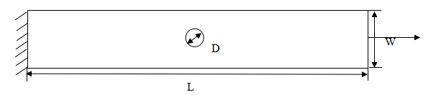
Abaqus Simulation
—Modeling Technique
Modeling method：
在厚度方向上建立一层单元vs建立与层合板相同层数的单元
solid element （C3D8R）vs continuum shell element（SC8R）
不同建模方式的对比：meshpart vs composite layup
左图为 铺层的层合板尺寸图，长度L为203mm，宽度W为25.4mm，孔的直径D为6.35mm，单层层合板的厚度h为0.13mm。
 | 单元划分方法 | ply1初始失效位移（mm） | ply2初始失效位移（mm） | ply11初始失效位移（mm） | ply12初始失效位移（mm） | 拉伸极限载荷（N）
solid element (C3D8R) | 1层单元 | 0.75 | 0.57 | 0.75 | 0.57 | 29456.2
 | 24层单元 | 0.75 | 0.57 | 0.75 | 0.57 | 29516.4
 | meshpart | 0.74 | 0.5 | 0.68 | 0.5 | 26229.9
continum shell (SC8R) | 1层单元 | 0.75 | 0.57 | 0.75 | 0.57 | 30501.7
 | 24层单元 | 0.75 | 0.57 | 0.75 | 0.57 | 30140.8
 | meshpart | 0.74 | 0.56 | 0.68 | 0.5 | 26964.5
Test ultimate loading：
28394.6N
Considering the efficiency and accuracy, we use SC8R and composite layup to build the model in Abaqus,and mesh one element in the thickness direction.

Slide 13
Abaqus Simulation
—UMAT subroutine
after each increment
UMAT Overview：
1 can be used to define the mechanical constitutive behavior of a material;
2 will be called at all material calculation points of elements for which the material definition includes a user-defined material behavior;
3 must update the stresses and solution-dependent state variables to their values at the end of the increment for which it is called;
4 Jocobian Matrix of the material must be supplied by users：
UMAT Flowchart
calculate strain and undamaged stiffness matrix
calculate damage variable d and
calculate stress
damaged
calculate damaged stiffness matrix C_{d}
checkout failure ( Hashin
criterion)
undamaged
calculate stress and Jacobian matrix ;update damage variable d
quit UMAT,back to main program

Slide 14
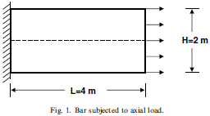
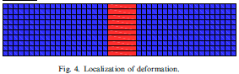
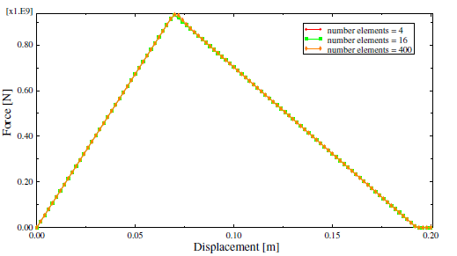
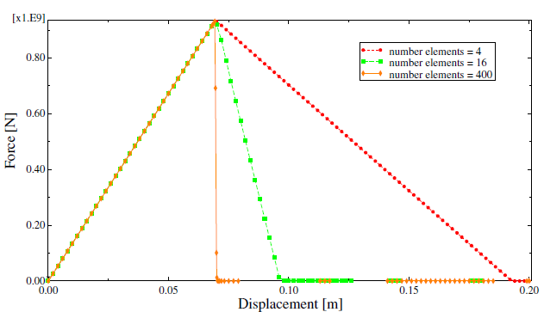
Abaqus Simulation
—characteristic length
Mesh Dependency：
When the material exhibits strain-softening behavior, leading to strain localization, this formulation results in a strong mesh dependency of the finite element results in that the energy dissipated decreases upon mesh refinement.The energy dissipated is proportional to the volume of the failed element.
To correct this behavior we use the crack band model,In this model the strength limit is not kept constant but is adjusted in such a way that the fracture energy is preserved
Different methods have been suggested for computing the characteristic length.In the current model, we assume that the characteristic length at a material point is equal to the square root of the area associated with it.
Lapczyk I, Hurtado J A. Progressive damage modeling in fiber-reinforced materials[J]. Composites Part A Applied Science & Manufacturing, 2007, 38(11):2333-2341.
Notes:
为了说明这个问题，我们考虑一个施加了单向拉伸的棒，此棒由线弹性材料组成，直到应力达到峰值，并且在此后的构型中线性软化。更进一步，我们假设在垂直于轴线方向有一条很窄的材料带，这个地方的强度比材料其他地方要稍低一些。从有限元的力-位移响应解显示出有很强的网格依赖性。清晰的显示出随着单元尺寸的减小，断裂所做的外部功不断减少。应变局部化被限制与一个单元厚度的一层上。能量耗散和失效单元的体积成正比，而不是断裂表面的面积，随着网格划分的细密，能量耗散趋于0.
为了纠正这个行为，我们使用裂纹带模型，在这个模型中，断裂被做成一个平行的密集分布的微裂纹带（一个弄脏的裂纹带）在这个模型中，强度极限应变ef并不是固定的而是按照公式来调整，使得总的断裂能保持不变bao。(公式略)
Lc为单元的特征长度，Gc是断裂能，这是一个材料性能，必须要被确定，Lc可以有不同的方法来计算

Slide 15
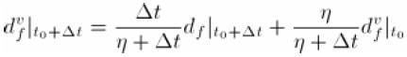
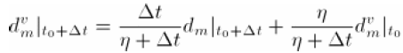
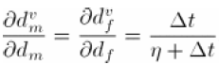
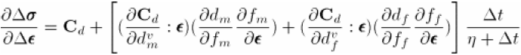
Abaqus Simulation
—coefficient of viscosity
To improve convergence, a technique based on viscous regularization (a generalization of the DuvautLions
regularization) of the damage variables is implemented in the user subroutine. In this technique we do not use the damage variables calculated from the aforementioned damage evolution equations directly; instead, the damage variables are “regularized” via the following equations:
the above equations are discretized in follows:
From the above expressions it can be seen that:
Therefore, the Jacobian matrix can be further formulated as follows:
Care must be exercised to choose an appropriate value for since a large value of viscosity might cause a noticeable delay in the degradation of the stiffness.
Abaqus Example Problem Manual:Failure of blunt notched fiber metal laminates

Slide 16
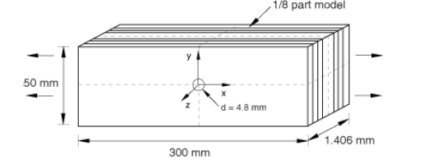
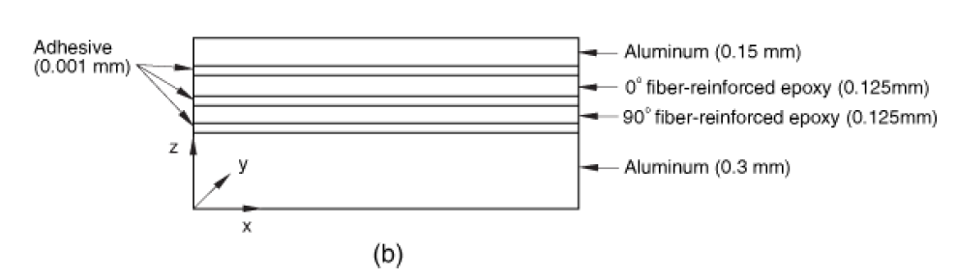
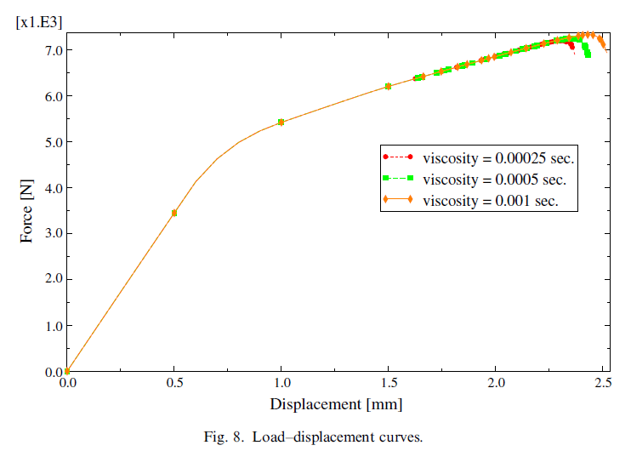
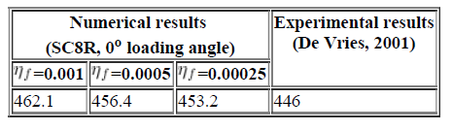
Abaqus Simulation
—coefficient of viscosity
Numerical example
Net blunt notch strength (MPa) for different values of the viscosity parameter in fiber direction(using built-in
fiber reinforced material damage model, viscosity in the matrix direction =0.005).
Lapczyk I, Hurtado J A. Progressive damage modeling in fiber-reinforced materials[J]. Composites Part A Applied Science & Manufacturing, 2007, 38(11):2333-2341.

Slide 17
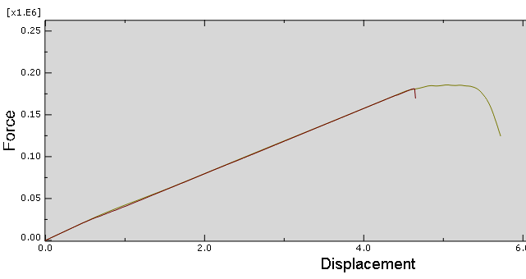
Abaqus Simulation
—implicit dynamic
The use of an implicit dynamic finite element model enables the prediction of the load drop that occurs when the specimens fail catastrophically.
Prediction of size effects in notched laminates using continuum damage mechanics，P.P. Camanho a,*, P. Maimı´ b, C.G. Da´vila ,Composites Science and Technology 67 (2007) 2715–2727
此处分析步的time period设为60，时间长度越大，越接近脆性。
将密度设为小值，保持不受惯性力的影响
implicit dynamic analysis VS static analysis

Slide 18
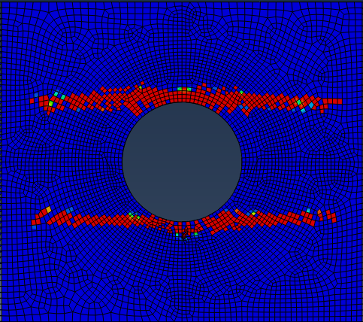
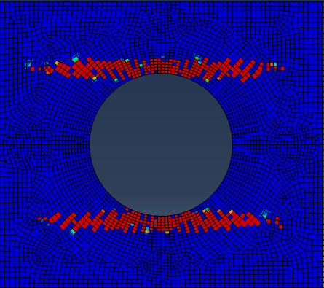
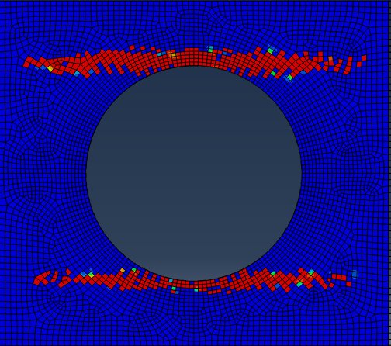
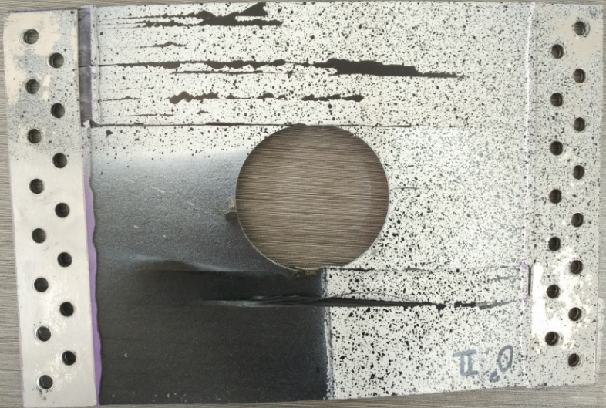
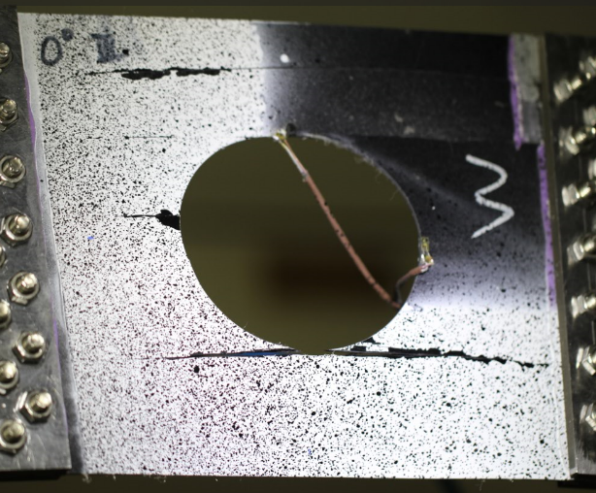
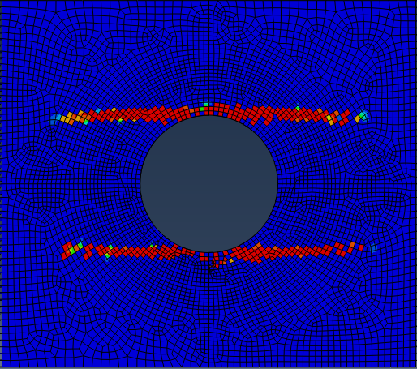
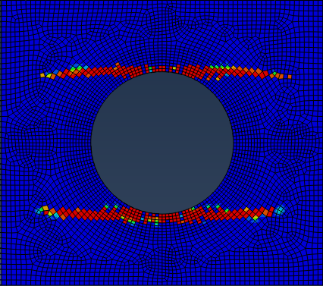
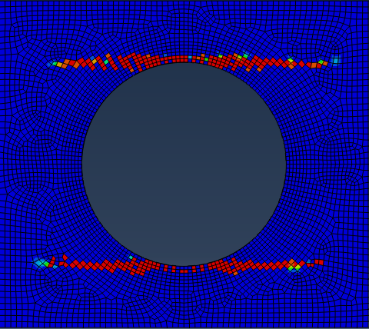
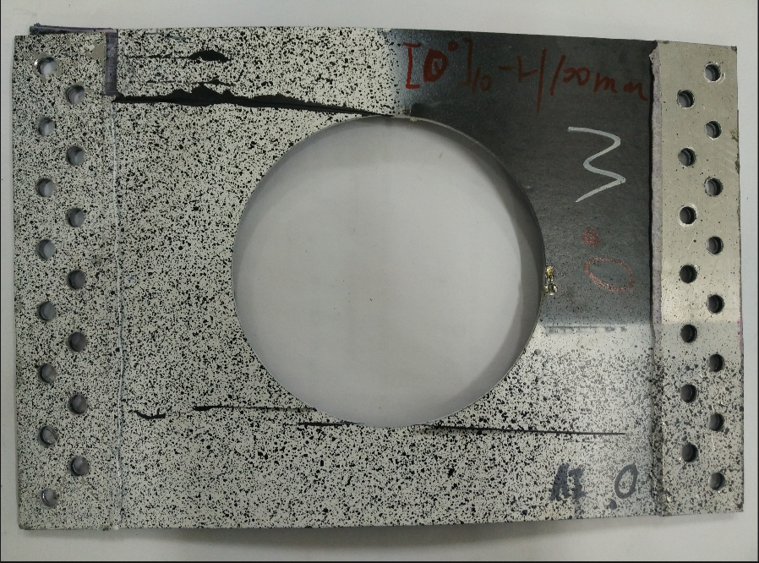
[0]₁₀
Results：
Failure evolution：
Linear degenaration
Exponential degenaration
60mm
80mm
100mm

Slide 19
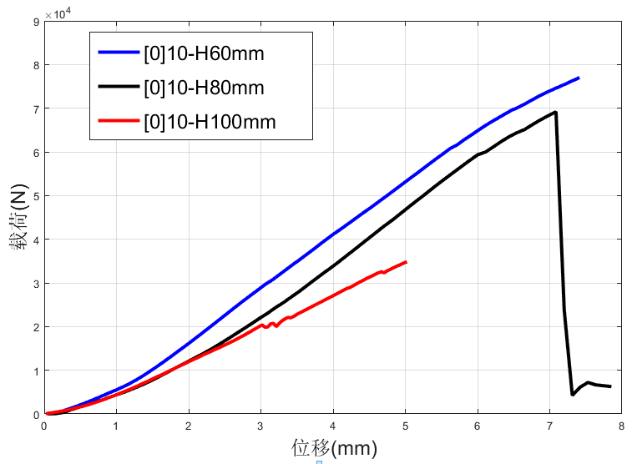
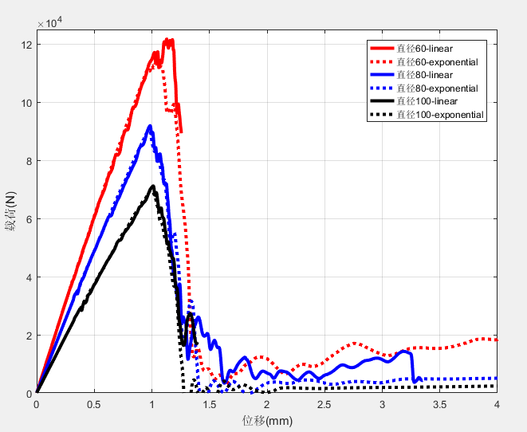
[0]₁₀
Results：
Ultimate loading：
Simulation
Experiment
[0]₁₀ | Size of cutout (Ф)
 | 60mm |  |  | 80mm |  |  | 100mm
 | Simul. | Exp. | Relative error | Simul. | Exp. | Relative error | Simul. | Exp. | Relative error
linear | 120 | 78.23 | 53% | 91.90 | 69.73 | 32% | 71.18 | 35.00 | 103%
exponential | 113.46 |  | 45% | 91.36 |  | 31% | 70.77 |  | 102%
1、从试验以及模拟的结果来看，裂纹的扩展和孔径大小无关，孔径越小，极限载荷越大
2、计算结果可以表现出[0]₁₀ 铺层的脆性破坏，linear模型以及exppnential模型对载荷以及损伤演化的影响不太大
3、极限载荷的误差较大

Slide 20




[0]₁₀
Results：
With smaller Xt：
[0]₁₀ | 1 | 2 | 3 | Mean | 纤维拉伸强度(Mpa)
第一组实验 | 23263 | 21804 | 20474 | 21847 | 21847/(15*1.5)=970.98
第一组实验 | 47480.5 | 43915.5 | 45268 | 45554.67 | 45554.67/(20*1.5)=1518.49
Xt=970
第一组试验纤维方向不对，测试结果可能不对
60mm
80mm
100mm
[0]₁₀ | Size of cutout (Ф)
 | 60mm |  |  | 80mm |  |  | 100mm
 | Simul. | Exp. | Relative error | Simul. | Exp. | Relative error | Simul. | Exp. | Relative error
Xt=1441.6 | 120 | 78.23 | 53% | 91.90 | 69.73 | 31.8% | 71.18 | 35.00 | 103%
Xt=970.98 | 78.74 |  | 0.7% | 61.55 |  | 11.7% | 47.79 |  | 36.5%
将Xt由1441.6改为970.98后，极限载荷更加精确，由此也可以看出[0]₁₀的强度主要由纤维拉伸强度决定

Slide 21















Results：
[0/90]₅
Failure evolution：Linear degenaration
0 ply
90 ply
60mm
80mm
100mm
fiber
matrix
fiber
matrix

Slide 22












Results：
[0/90]₅
Failure evolution：Exponential degenaration
0 ply
90 ply
60mm
80mm
100mm
fiber
matrix
fiber
matrix

Slide 23


Results：
[0/90]₅ 铺层各孔径试验位移载荷图
[0/90]₅
Ultimate loading：
Simulation
Experiment
[0/90]₅ | 60 |  |  | 80 |  |  | 100
 | Simul. | Exp. | Relative error | Simul. | Exp. | Relative error | Simul. | Exp. | Relative error
Linear | 52.67 | 59.32 | 11.2% | 43.83 | 47.20 | 7.1% | 34.56 | 37.54 | 7.9%
Exponential | 56.72 |  | 4.4% | 48.17 |  | 2.1% | 34.59 |  | 7.9%
1、从试验以及模拟的结果来看，裂纹的扩展和孔径大小无关，孔径越小，极限载荷越大
2、计算结果可以表现出[0/90]₅板的脆性断裂，
3、linear或是exponential模型对损伤演化的影响不太大，极限载荷：exponential比linear误差更小

Slide 24









Results：
[±45]₅
Failure evolution：
Linear degenaration
Exponential degenaration
60mm
80mm
100mm

Slide 25


[±45]₅
Results：
Ultimate loading：
Simulation
Experiment
孔径 | 60 |  |  | 80 |  |  | 100
[±45]5 | Simul. | Exp. | Relative error | Simul. | Exp. | Relative error | Simul. | Exp. | Relative error
Lin | 21.41 | 28.72 | 25.5% | 17.03 | 23.79 | 28.4% | 12.75 | 17.60 | 27.6%
Exp | 27.34 |  | 4.8% | 21.73 |  | 8.7% | 16.09 |  | 8.6%
1、从试验以及模拟的结果来看，裂纹的扩展和孔径大小无关，孔径越小，极限载荷越大
2、linear或是exponential模型对损伤演化的影响不太大，极限载荷：exponential比linear误差更小
4、位移载荷曲线的形状和实验相差大

Slide 26

[±45]₅
Results：
Shear Nonlinearity:
shear nonlinearity constitutive relations for the laminates were defined with the Ramberg-Osgood equation:
n is a parameter define the shape of the nonlinear stress-strain relationship.
The displacement-load curve is closer to the experiment when N equals to 2.

Slide 27



[±45]₅
Results：
Shear Nonlinearity:
No Shear Nonlinearity
N=2
Experiment
Problem:The load of the curve doesn't drop in the simulation result.
孔径 | 60 |  |  | 80 |  |  | 100
[±45]5 | Simul. | Exp. | Relative error | Simul. | Exp. | Relative error | Simul. | Exp. | Relative error
No shear nonlinearity | 27.34 | 28.72 | 4.8% | 21.73 | 23.79 | 8.7% | 16.09 | 17.60 | 8.6%
Shear nonlinearity | 26.81 |  | 6.7% | 21.39 |  | 10.1% | 16.01 |  | 9.0%

Slide 28



Results：in-situ effect
let A、B、C、D=1,we can obtain:
材料参数 铺层 | 纤维拉伸强度Xt | 剪切强度Sxy | 纤维断裂能Gm
[0]₁₀ | 970 | 63 | 0.5
[0/90]₅ | 1455 | 95 | 5
[±45]₅ | 1455 | 95 | 5
[0]₁₀
Sxy = 95;Gm = 5
Sxy=63;Gm = 5
Sxy=63;Gm = 0.5

Slide 29








Results：Compare with Ply-Discount method
Ply-Discount method：
CDM method：
[0]₁₀
[±45]₅
[0/90]₅

Slide 30

Results：Compare with Ply-Discount method
Comparing of Ultimate loads Layer | Size of cutout (Ф)
 | 60mm |  |  | 80mm |  |  | 100mm
 | Exp. | ply-discount | CDM | Exp. | ply-discount | CDM | Exp. | ply-discount | CDM
[0]₁₀ | 78.23 | 19.9% | 0.7% | 69.73 | -8.4% | 11.7% | 35.00 | -34% | 36.5%
[0/90]₅ | 59.32 | 4.0% | 4.4% | 47.20 | 2.8% | 2.1% | 37.54 | 12.1% | 7.9%
[±45]₅ | 28.72 | 21.8% | 6.7% | 23.79 | 24.8% | 10.1% | 17.60 | 23.8% | 9.0%
Ply-Discount
CDM
Experiment

Slide 31

Conclusions：
Based on the simulation and experiments:
1、Failure onset is at the stress concentration area,ultimate strength is effected by the design of ply sequences and decreases with size of cutout increase;
2、The failure evolution of laminates doesn't affected by the size of cutout,and the failure of each single layer always includes different failure modes.
2、The simulation using the continuum damage model exhibit the brittle failure of the composite laminates as the experiment shows,while the ply discount method can only predict the ultimate strength of composite laminates;
3、The continuum damage model preforms well for predicting the failure evolution behavior of composite laminates with big cutouts;
4、The exponential degeneration law performs better than linear degeneration law fro pridecting the ultimate strength in this simultion.
5、The shear nonlinearity must be considered for the [±45]₅ layup laminates to obtain the displacement-force curve.
6、The in-situ effect should be considered,the strength should be calculated respectively for each layup of the laminates.
7、The UMAT subroutine are more flexible and abundant than the build-in model in ABAQUS,it is convenient to apply other theory like shear nonlinearity and in-situ effect.
8、The finite element based failure model of composite laminates can be used in composite structures with arbitrary configurations under complex stress states to make up for the shortage of analytical failure analysis.

Slide 32
Future work：
stress concentration factor：
bulking and failure(optimize and design for composite laminates)：
cohesive element

